Slide 1
Outline
Traditional Problem about Wang tile
Paper Solution
Implement Problem
Our approach
Result

Slide 2
Motivation - Corner problem

Slide 3
Motivation-- Joint problem

Slide 4
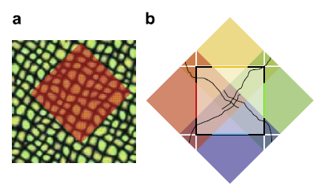
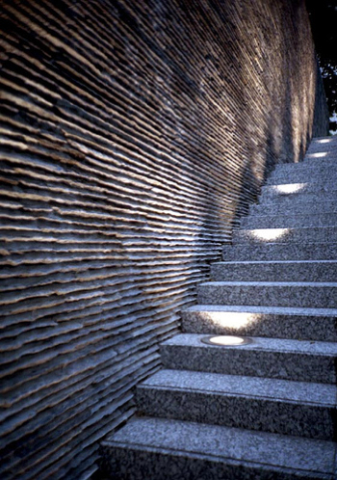
Motivation—sampling problem

Slide 5
Strict Wang tile
No sampling problem
But Need many precomputatative time

Slide 6
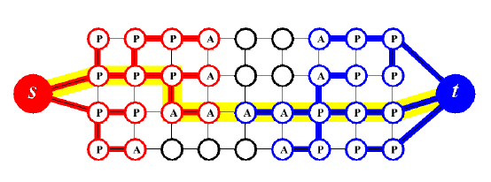
Problem 1—Graph cut?
Edmonds-Karp algorithm and Ford-Fulkerson algorithm is very slow due to recursively call

Slide 7

How to connect Graph cut

Slide 8
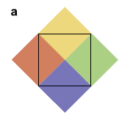
Problem2

Slide 9
學長的可行方法

Slide 10
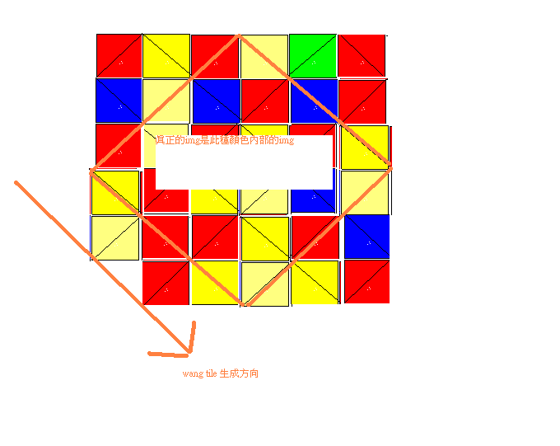
Solution1

Slide 11
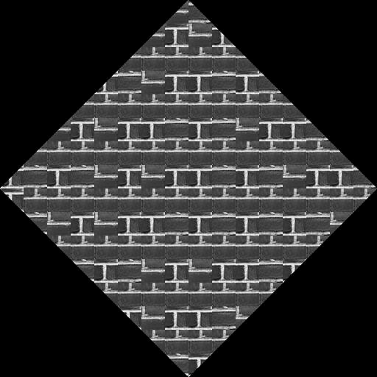
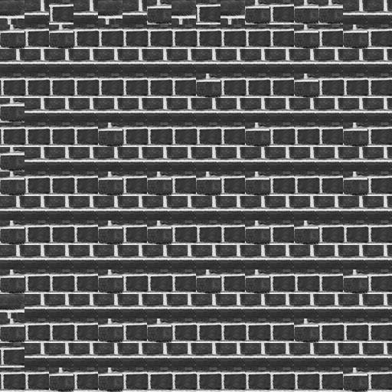
Problem for Solution 1

Slide 12
Solution 2

